Slide 1

Algebra 1
Unit 2, Lesson 4 Introducing Polynomials Volume 1, pg. 72

Slide 2


Benchmark
MA.912.AR.1.3
Add, subtract, and multiply polynomial expressions with rational number coefficients.
volume 1, pg. 72

Slide 3
Integrated Mathematical Thinking and Reasoning Standards
MA.K12.MTR.2.1 Demonstrate understanding by representing problems in multiple ways.
MA.K12.MTR.4.1 Engage in discussions that reflect on the mathematical thinking of self and others.
MA.K12.MTR.5.1 Use patterns and structure to help understand and connect mathematical concepts.
volume 1, pg. 72

Slide 4

Learning Targets
I can write polynomials in standard form.
I can multiply a monomial to a polynomial.
volume 1, pg. 72

Slide 5

Warm-Up
volume 1, pg. 73

Slide 6
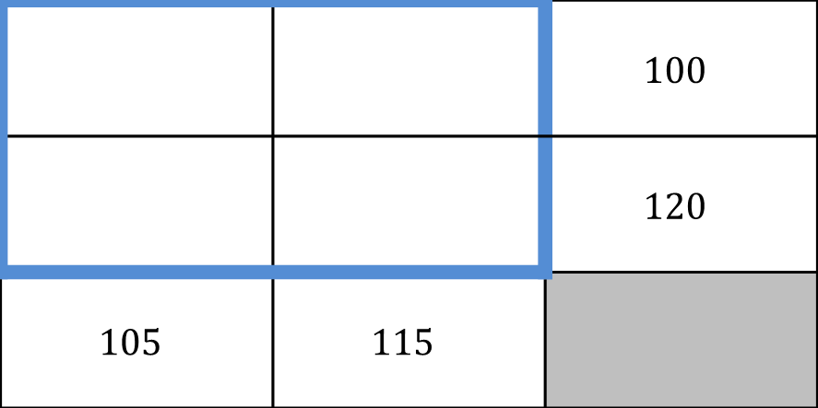
2.4.1 Warm-Up: Number Puzzle
Solve the puzzle by filling in each blank cell in the blue box so that each row and column has the sum shown. Each cell must contain a different value.
 |  | $$100$$
 |  | $$120$$
$$105$$ | $$115$$
volume 1, pg. 73
Notes:
Video Link: https://algebranation.wistia.com/medias/fi4fidi5y8

Slide 7

Exploration
volume 1, pg. 73

Slide 8
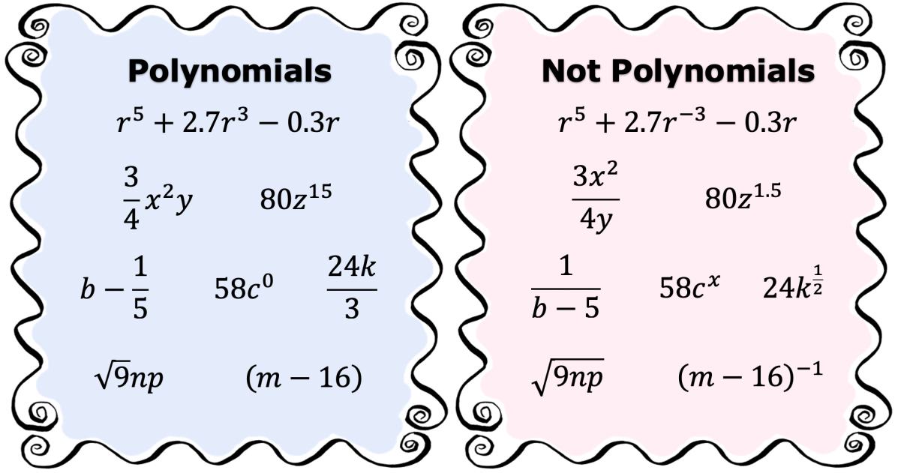
2.4.2 Exploration: Defining a Polynomial
The charts show several examples and non-examples of polynomials.
volume 1, pg. 73

Slide 9
Create a list of identifying features polynomials can have versus those polynomials cannot have.
Polynomials can have ... | Polynomials cannot have …
volume 1, pg. 73

Slide 10
Compare your lists with your partner. Add any additional features you found after your discussion.
With your partner, write a definition for polynomial.
volume 1, pg. 74

Slide 11
Ask two other pairs of partners the definition they wrote. Listen to their definition and write a summary. You are the only person who should write in the first column of the table. Have the person initial next to your summary stating that your summary of their definition was accurate.
After reviewing the definitions created by your classmates, go back to your definition and make revisions, if needed.
My Summary of the Definition of a Polynomial | Initials
volume 1, pg. 74

Slide 12
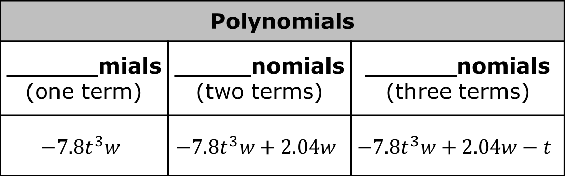
Some polynomials are described with specific names based on the number of terms.
Four prefix options are given.
Match the prefixes to identify the types of polynomials in the table based on the description and examples.
Prefixes
tri- | mono- | poly- | bi-
Polynomials
______mials (one term) | _____nomials (two terms) | ______nomials (three terms)
$$−7.8t^{3}w$$ | $$−7.8t^{3}w+2.04w$$ | $$−7.8t^{3}w+2.04w−t$$
volume 1, pg. 75

Slide 13
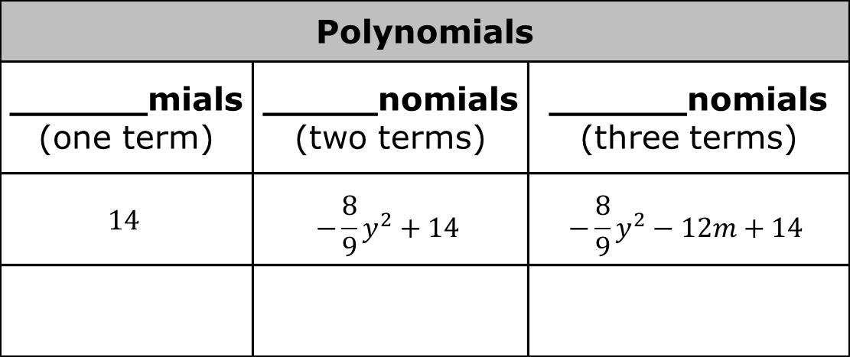
In the last row of the table, create your own polynomial that fits each category.
Polynomials
______mials (one term) | _____nomials (two terms) | ______nomials (three terms)
$$14$$ | $$−\frac{8}{9}y^{2}+14$$ | $$−\frac{8}{9}y^{2}−12m+14$$
volume 1, pg. 75

Slide 14

Guided Instruction
volume 1, pg. 75

Slide 15


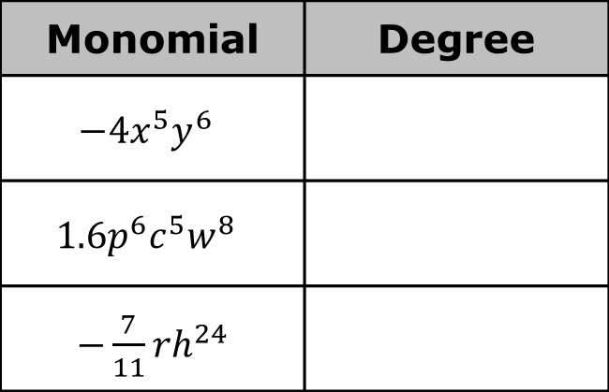
2.4.3 Guided Instruction: Polynomials and Standard Form
A monomial is a polynomial with one term.
The degree of a monomial is the sum of the exponents of the variables in a monomial.
Identify the degree of each monomial.
Monomial | Degree
$$−4x^{5}y^{6}$$
$$1.6p^{6}c^{5}w^{8}$$
$−\frac{7}{11}rh^{24}$
volume 1, pg. 75

Slide 16

What is the degree of $62{pk}^{8}+7a^{2}b^{5}−38g^{4}h^{6}$?
A polynomial is the sum or difference of terms which have variables raised to non-negative integer powers and which have coefficients that may be real or complex.
The degree of a polynomial is the greatest degree of the monomials in a polynomial.
volume 1, pg. 75

Slide 17
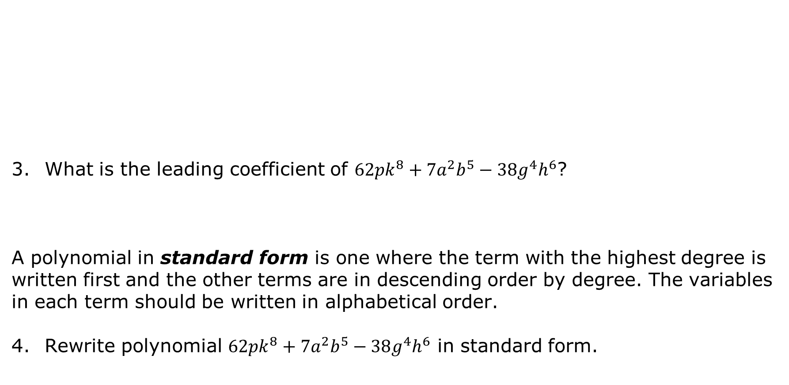
What is the leading coefficient of $62{pk}^{8}+7a^{2}b^{5}−38g^{4}h^{6}$?
A polynomial in standard form is one where the term with the highest degree is written first and the other terms are in descending order by degree. The variables in each term should be written in alphabetical order.
Rewrite polynomial $62{pk}^{8}+7a^{2}b^{5}−38g^{4}h^{6}$ in standard form.
The leading coefficient is the coefficient of the first term of a polynomial whose terms are written in descending order from largest degree to smallest degree.
volume 1, pg. 76

Slide 18

Collaboration
volume 1, pg. 76

Slide 19
2.4.4 Collaboration: Polynomials and Standard Form
Work with your partner to complete the following.
Three polynomials are given in the table.
Determine whether each polynomial is written in standard form. If it is not, rewrite it in standard form.
Then, in the second column, identify the features of each polynomial.
volume 1, pg. 76

Slide 20
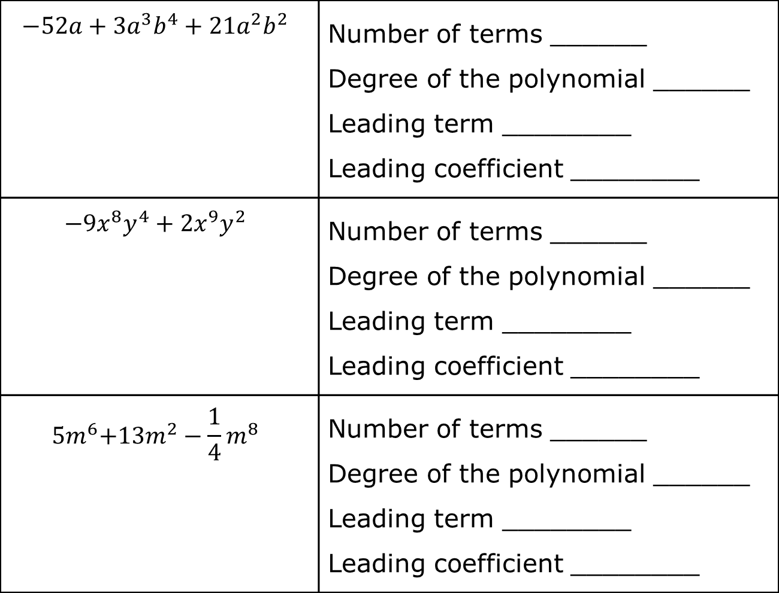
$${−52a+3a}^{3}b^{4}+21a^{2}b^{2}$$ | Number of terms ______ Degree of the polynomial ______ Leading term ________ Leading coefficient ________
$$−9x^{8}y^{4}+2x^{9}y^{2}$$ | Number of terms ______ Degree of the polynomial ______ Leading term ________ Leading coefficient ________
$${ 5m}^{6}+{13m}^{2}−\frac{1}{4}m^{8}$$ | Number of terms ______ Degree of the polynomial ______ Leading term ________ Leading coefficient ________
volume 1, pg. 76

Slide 21
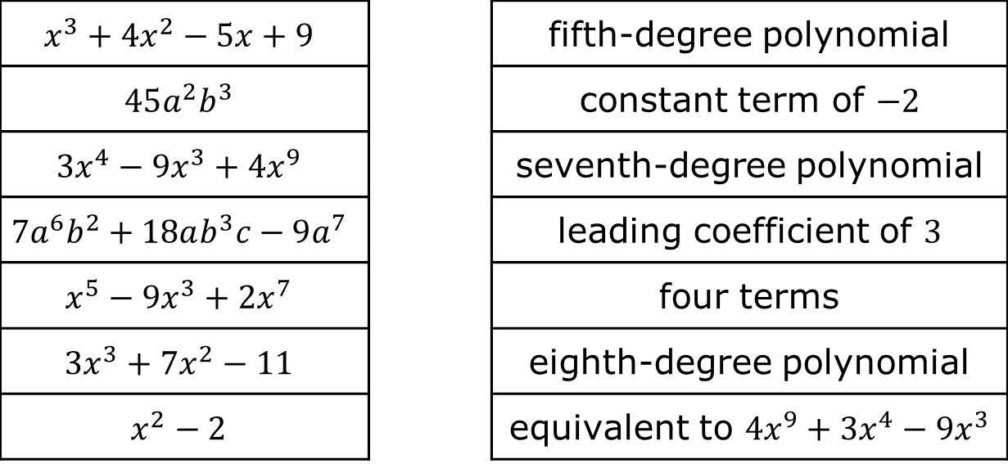
With your partner, match the polynomial in the left column by drawing an arrow to its descriptive feature in the right column.
$$x^{3}+4x^{2}−5x+9$$ |  | fifth-degree polynomial
$$45a^{2}b^{3}$$ |  | constant term of $−2$
$$3x^{4}−9x^{3}+4x^{9}$$ |  | seventh-degree polynomial
$$7a^{6}b^{2}+18ab^{3}c−9a^{7}$$ |  | leading coefficient of $3$
$$x^{5}−9x^{3}+2x^{7}$$ |  | four terms
$$3x^{3}+7x^{2}−11$$ |  | eighth-degree polynomial
$$x^{2}−2$$ |  | equivalent to $4x^{9}+3x^{4}−9x^{3}$
volume 1, pg. 77

Slide 22

Refresher
volume 1, pg. 77

Slide 23

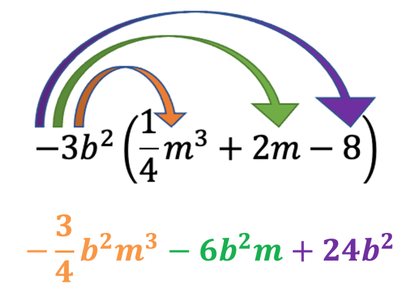
2.4.5 Refresher: Distributing a Monomial to a Polynomial
The distributive property of multiplication over addition applies to polynomials. Recall that the distributive property “distributes” a factor to all terms within a set of parentheses.
An example of distributing a monomial to a polynomial is shown.
volume 1, pg. 77

Slide 24
Discuss with your partner what operation the arrows are demonstrating in the example.
In the resulting product, why are the first two terms negative while the third term is positive?
volume 1, pg. 77

Slide 25

Guided Practice
volume 1, pg. 78

Slide 26

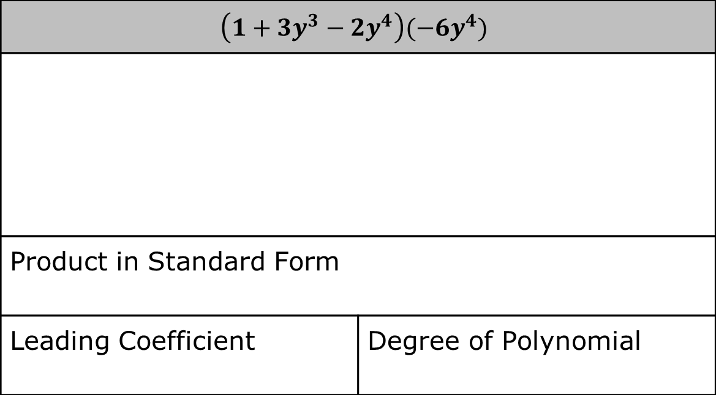
2.4.6 Guided Practice: Distributing a Monomial to a Polynomial
Find each product by distributing the monomial to the polynomial. Then, complete the table for the resulting product.
$$\left(1+3y^{3}−2y^{4}\right)(−6y^{4})$$
Product in Standard Form
Leading Coefficient | Degree of Polynomial
volume 1, pg. 78

Slide 27
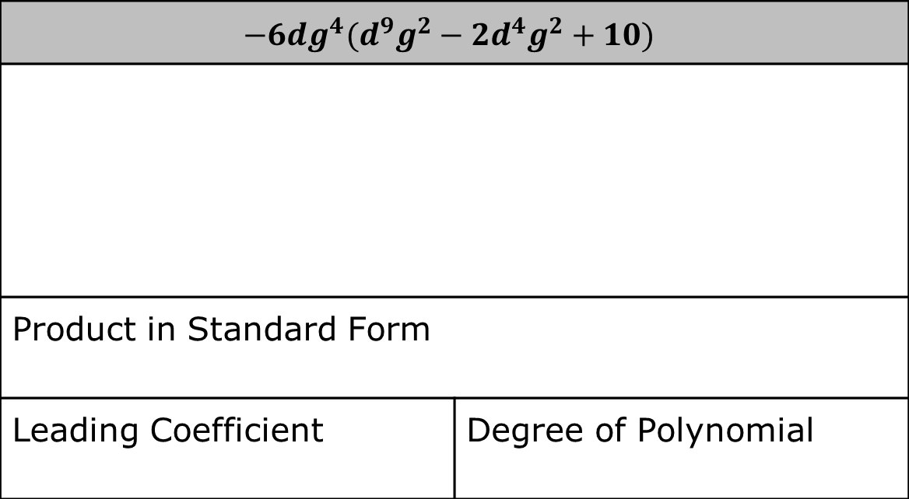
$$−6dg^{4}(d^{9}g^{2}−2d^{4}g^{2}+10)$$
Product in Standard Form
Leading Coefficient | Degree of Polynomial
volume 1, pg. 78

Slide 28
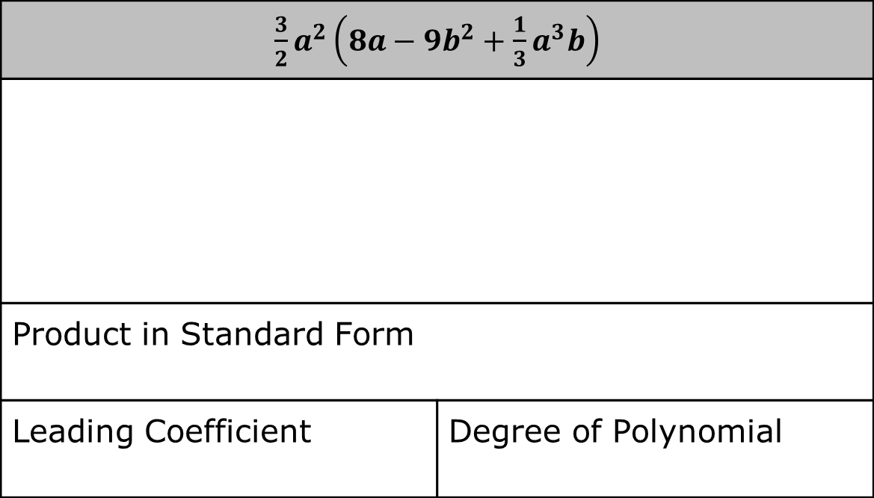
$\frac{3}{2}a^{2}\left(8a−9b^{2}+\frac{1}{3}a^{3}b\right)$
Product in Standard Form
Leading Coefficient | Degree of Polynomial
volume 1, pg. 78

Slide 29
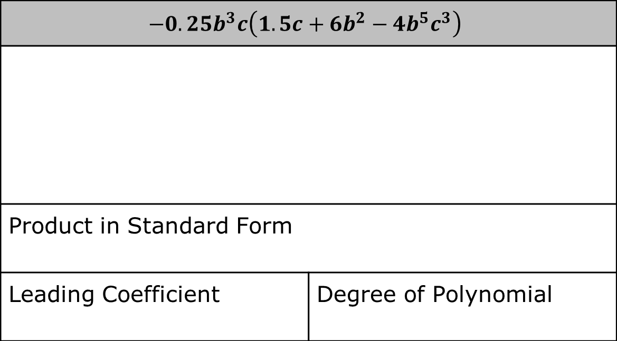
$$−0.25b^{3}c\left(1.5c+6b^{2}−4b^{5}c^{3}\right)$$
Product in Standard Form
Leading Coefficient | Degree of Polynomial
volume 1, pg. 78

Slide 30

Wrap-Up
volume 1, pg. 79

Slide 31
2.4.7 Wrap-Up: Growth Mindset
Mistakes are an opportunity to learn. Complete the statement to highlight a mistake you learned from.
My favorite mistake from today was …
Means
I
Start
To
Acquire
Knowledge
Experience
Skills
volume 1, pg. 79

